Slide 1
Lab 1 Introduction to MATLAB

Slide 2
Objectives
Work with MATLAB 2019b.
Mast the plotting skills.
The representation of elementary signals.
The operation of signals with MATLAB.
Familiar with the program structure.

Slide 3
MATLAB
Performing mathematical computations and signal processing.
Analyzing and visualizing data (excellent graphics tools).
Modeling physical systems and phenomena.
Testing engineering designs.
The fundamental data type is the array and the basic building block is the matrix.
数值分析，矩阵计算、数据可视化

Slide 4
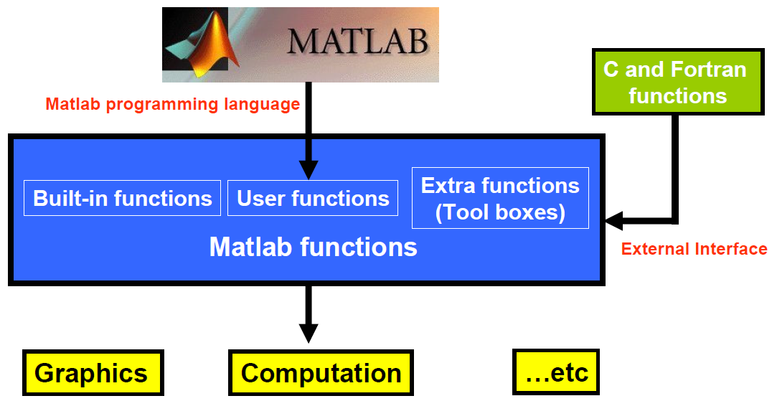
Structure of MATLAB

Slide 5
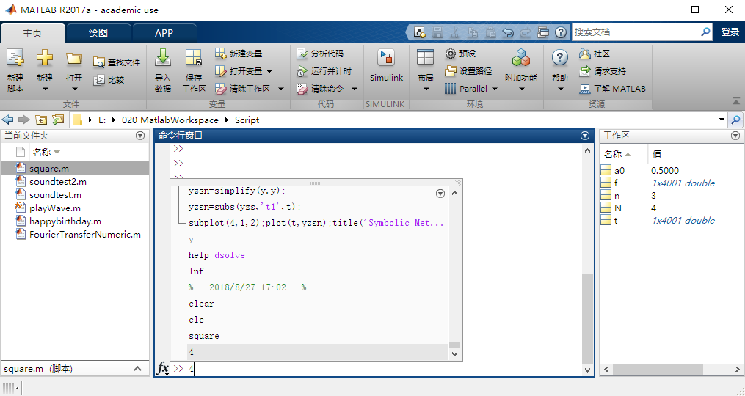
e.g.
Desktop of Matlab

Slide 6
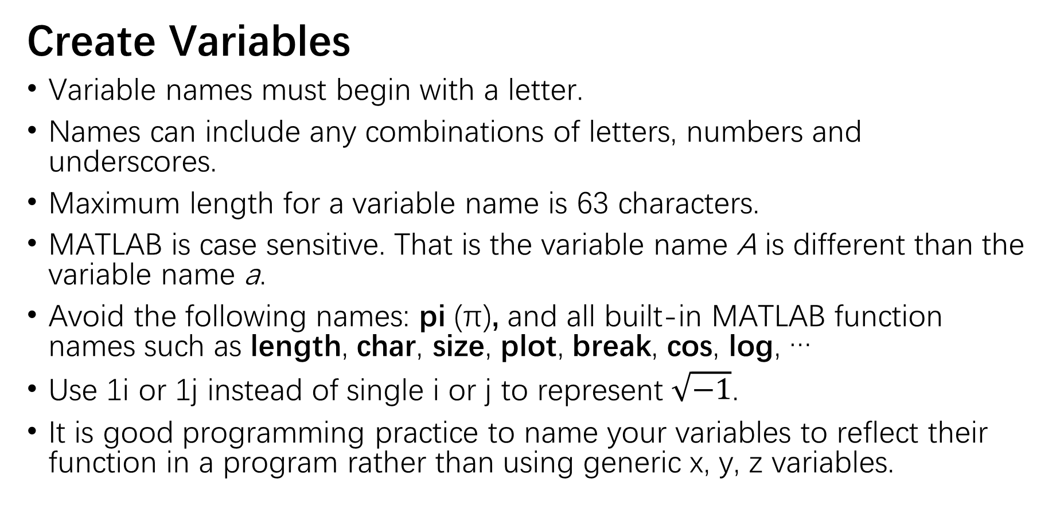
e.g.
Create Variables
Variable names must begin with a letter.
Names can include any combinations of letters, numbers and underscores.
Maximum length for a variable name is 63 characters.
MATLAB is case sensitive. That is the variable name A is different than the variable name a.
Avoid the following names: pi (π), and all built-in MATLAB function names such as length, char, size, plot, break, cos, log, …
Use 1i or 1j instead of single i or j to represent $\sqrt{−1}$.
It is good programming practice to name your variables to reflect their function in a program rather than using generic x, y, z variables.

Slide 7
e.g.
Plotting
Plotting function:
plot(X, Y); plot(Y); plot(_, LineSpec); plot(X1, Y1,…Xn, Yn);
stem(X, Y); stem(Y); stem(_, LineSpec); stem(_, ’filled’);
fplot(f); fplot(f, [xmin, xmax]); fplot(_, LineSpec)
Subplot
subplot(m,n,p);
Label
title(‘text’);
xlabel(‘text’); ylabel(‘text’);
Range
axis([Xmin Xmax Ymin Ymax]);
Grid
grid on/off; grid minor;
[X,Y] = meshgrid(x,y);
1
2
3
4

Slide 8
Plotting-LineSpec
Line stytle:
- -- : -.
Marker
O + * . x s d ^ v > < p h
Color
y m c r g b w k

Slide 9
Representation of Elementary Signal
Numerical method
Set a time range and sampling time interval
Generate the elementary signals with related function
Draw the signal with plot or stem
Symbolic method
Create symbolic objects with syms
Generate the elementary signals with related function
Draw the signal with fplot

Slide 10
e.g.
Functions to Generate Elementary Signal
sin(x): returns sine function of x
cos(x): returns cosine function of x
sinc(x): returns an array, y, those elements are the sinc of the elements of the input, x.
exp(tsobj): calculates the natural exponential (base e) of all the data in the data series of the financial time series object tsobj.
tripuls(t, w, s): returns a continuous, aperiodic, unity-height triangular pulse with width w and skew s, where -1≤s ≤1.
sawtooth(t,xmax): generates a sawtooth wave with period 2π for the elements of the time array t, and the maximum location at each period is controlled by xmax, where 0 ≤xmax ≤1.

Slide 11
Functions to Generate Elementary Signal
rectpuls(t,w): returns a continuous, aperiodic, unity-height rectangular pulse at the sample times indicated in array t, centered about t=0 and with a width of w.
square(t,d): generates a square wave with period 2π for the elements of the time array t and with specified duty cycle d. The duty cycle is the percent of the signal period in which the square wave is positive.
(t>=a): returns the value 0 for x‹0, 1 for x≥0.
heaviside(x): returns the value 0 for x‹0, 1 for x›0, and ½ for x=0.
dirac(x): represents the Dirac delta function of x.

Slide 12
e.g.
Symbol | Description
+ | Addition:A+B
- | subtractionA-B
* | Matrix multiplication. C = A*B is the linear algebraic product of the matrices A and B. For nonscalar A and B, the number of columns of A must equal the number of rows of B. A scalar can multiply a matrix of any size.
.* | Array multiplication. A.*B is the element-by-element product of the arrays A and B. A and B must have the same size, unless one of them is a scalar.
^ | Matrix power. X^p is X to the power p, if p is a scalar. If p is an integer, the power is computed by repeated squaring. If the integer is negative, X is inverted first. For other values of p, the calculation involves eigenvalues and eigenvectors, such that if [V,D] = eig(X), then X^p = V*D.^p/V.
.^ | Array power. A.^B is the matrix with elements A(i,j) to the B(i,j) power. A and B must have the same size, unless one of them is a scalar.
/ | Slash or matrix right division. B/A is roughly the same as B*inv(A).
./ | Right array divide. A./B is the matrix with elements A(i,j)/B(i,j). A and B must have the same size, unless one of them is a scalar.
\ | Backslash or left matrix divide. A\B is roughly the same as INV(A)*B.
.\ | Left array divide. A.\B is the matrix with elements A(i,j)\B(i,j). A and B must have the same size, unless one of them is a scalar.
' | Matrix transpose. A' is the linear algebraic transpose of A. For complex matrices, this is the complex conjugate transpose.
.' | Array transpose. A.' is the array transpose of A. For complex matrices, this does not involve conjugation.
: | Colon: generates an array having regularly spaced elements.
, | Comma: separates elements of an array.
; | Semicolon: suppresses screen printing; also denotes a new row in an array.
… | Ellipsis: continues a aline.
Signal Operation
Notice the difference between the operation with and without dot.

Slide 13
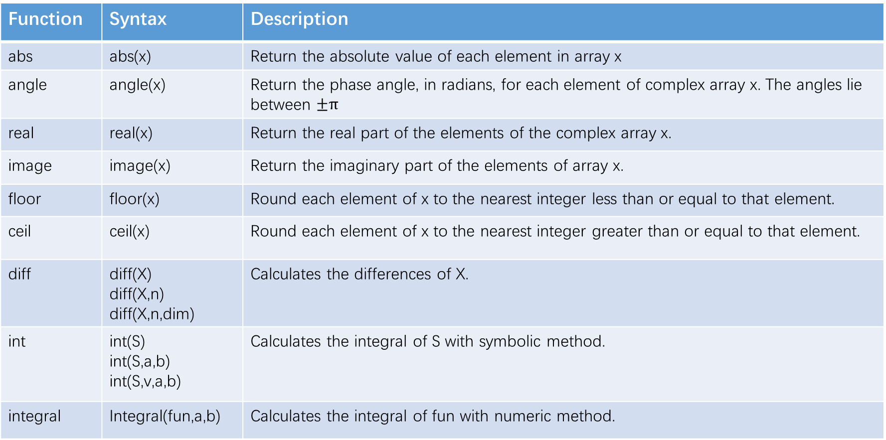
Signal Operation
Function | Syntax | Description
abs | abs(x) | Return the absolute value of each element in array x
angle | angle(x) | Return the phase angle, in radians, for each element of complex array x. The angles lie between $±π$
real | real(x) | Return the real part of the elements of the complex array x.
image | image(x) | Return the imaginary part of the elements of array x.
floor | floor(x) | Round each element of x to the nearest integer less than or equal to that element.
ceil | ceil(x) | Round each element of x to the nearest integer greater than or equal to that element.
diff | diff(X) diff(X,n) diff(X,n,dim) | Calculates the differences of X.
int | int(S) int(S,a,b) int(S,v,a,b) | Calculates the integral of S with symbolic method.
integral | Integral(fun,a,b) | Calculates the integral of fun with numeric method.

Slide 14


Program Structure
Sequential, Loop, Branch
Loop structure

Slide 15
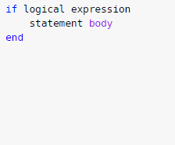
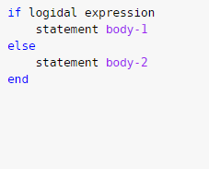
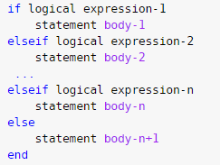
Program Structure
Branch structure
If-else-end

Slide 16
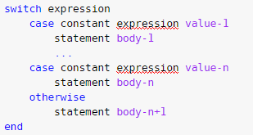
Program Structure
Branch structure
Switch

